Slide 1

MINI PROJECT Topic: Music Player Semester: V
Submitted To: Submitted by:
Mrs. Priya Agarwal Shubham Singh
(181500698)

Slide 2
INDEX
Introduction
Aim
Tools and Requirements
Features
Implementation
Screenshots
Enhancement Scope
Conclusion

Slide 3
Introduction
Music is important part of our life. We know that the music files are digital files.
Therefore, there is a need of a tool to run the digital files or in other words, play the files.
Thus, we need Music players. It is a device using to play MP3s and other digital audio files.

Slide 4
AIM
The main aim of this project is to design a cross-platform music player using Python and Tkinter.
That will help users play, pause and stop a track as per their needs.
The application will also help users to increase the volume of their device

Slide 5
Tools and Requirements
Hardware Requirements:
120 GB HDD
Minimum 4 GB RAM
Laptop/Desktop
i5 processor
Software Requirements:
Pycharm
Operating System(Windows, Linux)
Python 3.8
Tkinter (Python GUI library)
Pygame (Python Library)
OS module
Pickle module

Slide 6
Features
User will be able to play and listen to songs, MP3 files.
The player has a simple and easy to use GUI with options for various functions, display screen to display the entire playlist.
The player allows the user to browse through the contents of the computer drive to choose song/s to be played or queued.
It allows the user with option to pause or resume the song.
Also the user is able to play the previous or the next song in the playlist.

Slide 7
Implementation
Tkinter Library: used to make the GUI of the player
OS module: used to select the music files and display their name.
Tkinter import filedialog: used to select the directories to make the playlist.
Tkinter import Photoimage: used to display images in the player.
pygame import mixer: used to play, pause the music.
Pickle module: used for serializing and de-serializing a python object structure.
Pygame module: It is used for making multimedia applications.

Slide 8
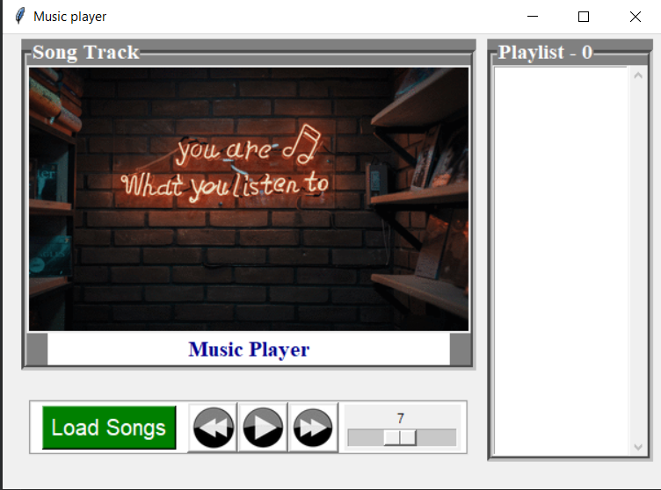
Screenshots

Slide 9
Enhancement Scope
Features like shuffle song, repeat song can be added.
Timer showing the duration of the song can be added.

Slide 10
Conclusion
It was a wonderful experience to learn new technology and implement it in a form of a project.
This music player has all the basic feature a user wants.
In future more features would be added to make it more interesting to use.

Slide 11


